Slide 1
Organization Hierarchy
PMO Head Office
Regional Head Office
Circle
Corporate Projects
Sales Projects
Real Estate Projects
OSS/BSS Applications
IN Projects
IT Projects
Regulatory Projects
Networks Projects

Slide 2
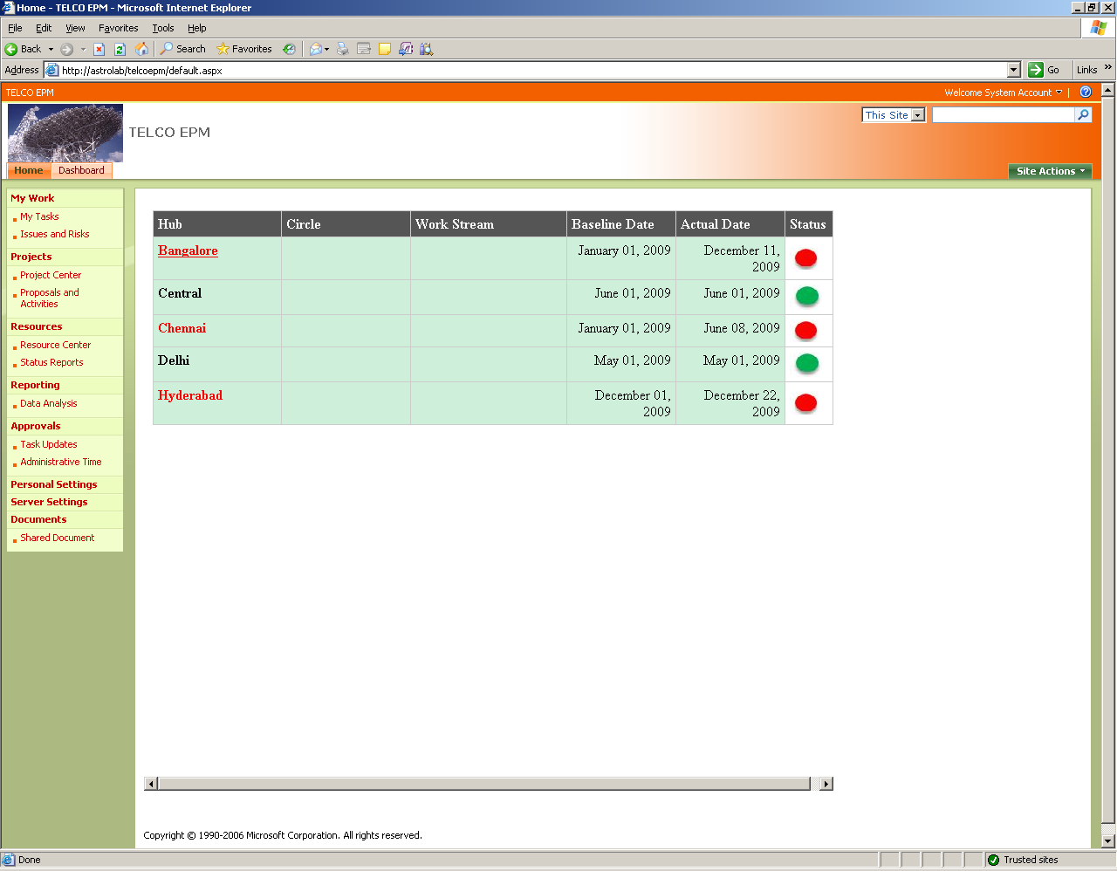
PMO Head Office - Dashboard

Slide 3
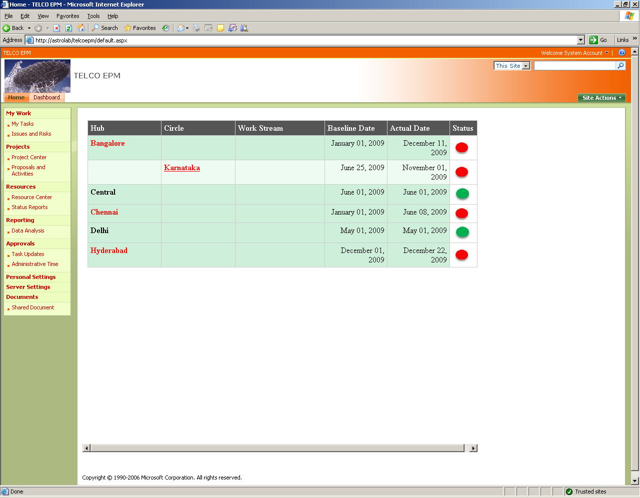

Slide 4
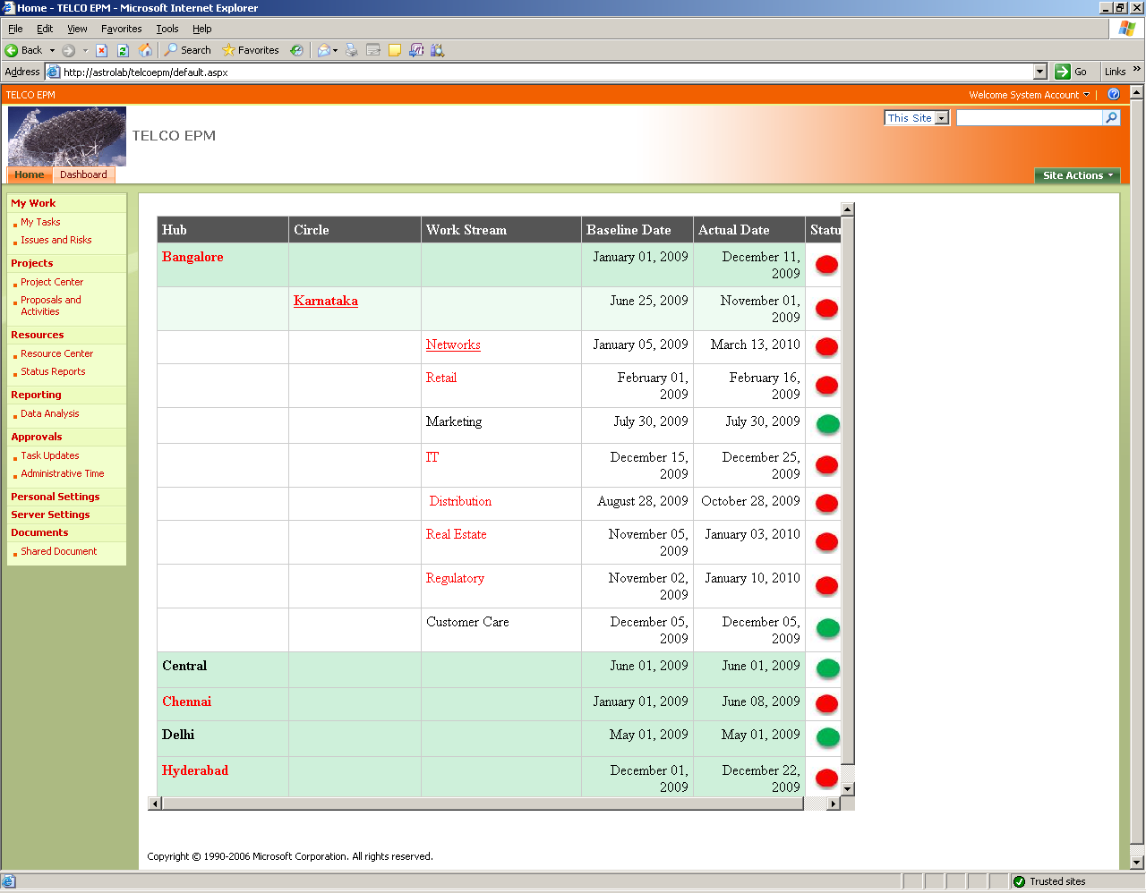

Slide 5
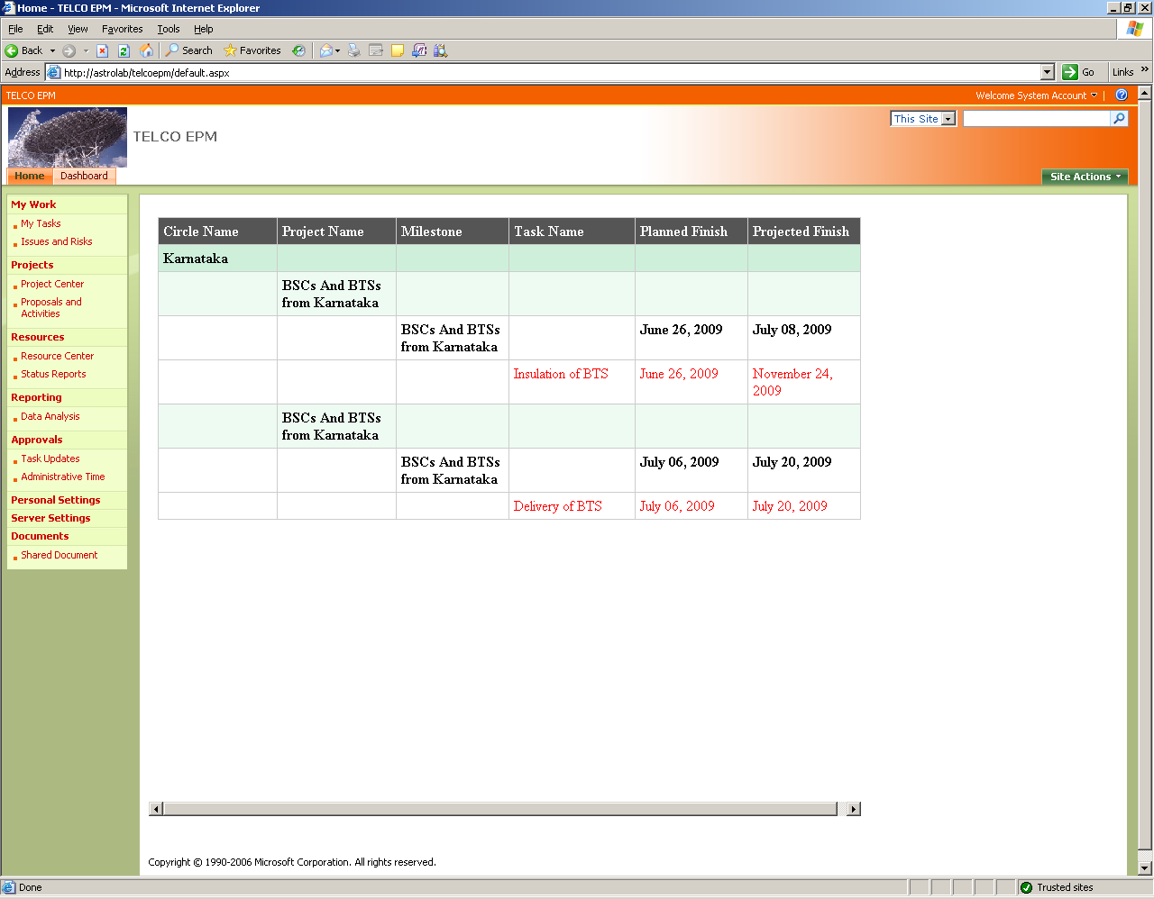


Slide 6
Sales Project Hierarchy
Sales Projects
Zone 1
Distribution Shortlisting
Distribution Shortlisting
Zone 2
Distribution Shortlisting
Agreement for Distributor
Agreement for Distributor
Infra Readiness
Recruitment
POS Appointment
Infra
Readiness
Recruitment
POS
Appointment

Slide 7
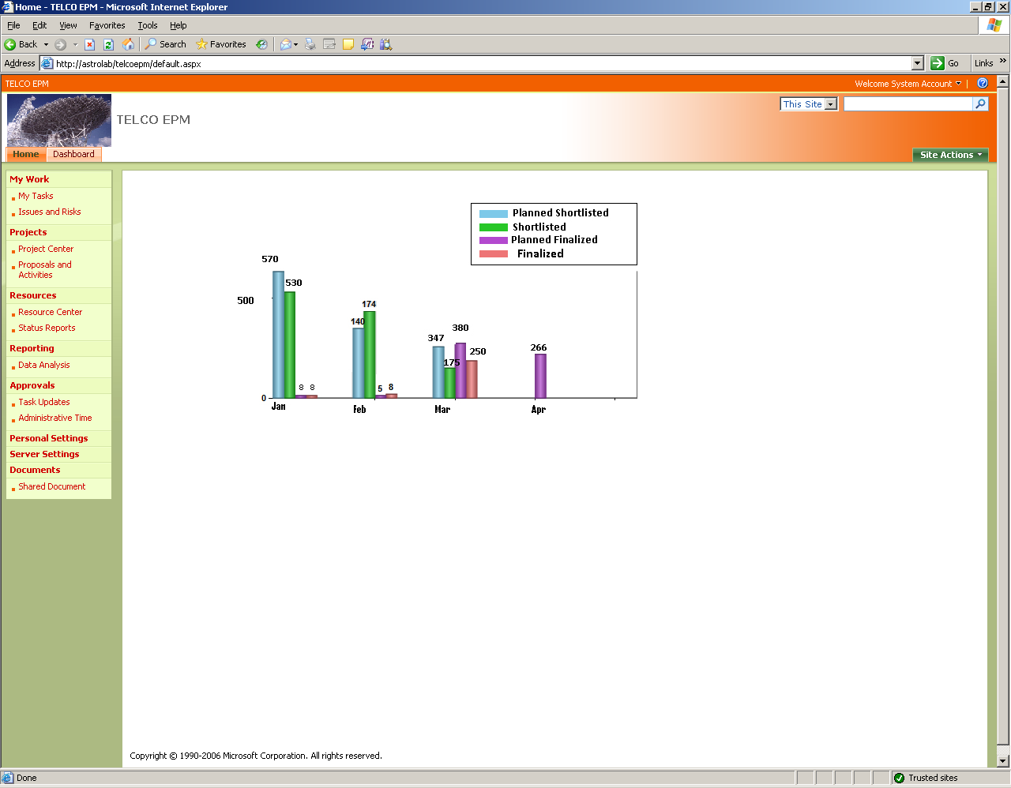
Distribution Shortlisting

Slide 8
Network Project Hierarchy
Network Projects
MSC1
BSC 1
BSC 2
MSC 2
BSC 3
BTS 1
BTS 2
BTS1
BTS 2
Chennai Circle

Slide 9
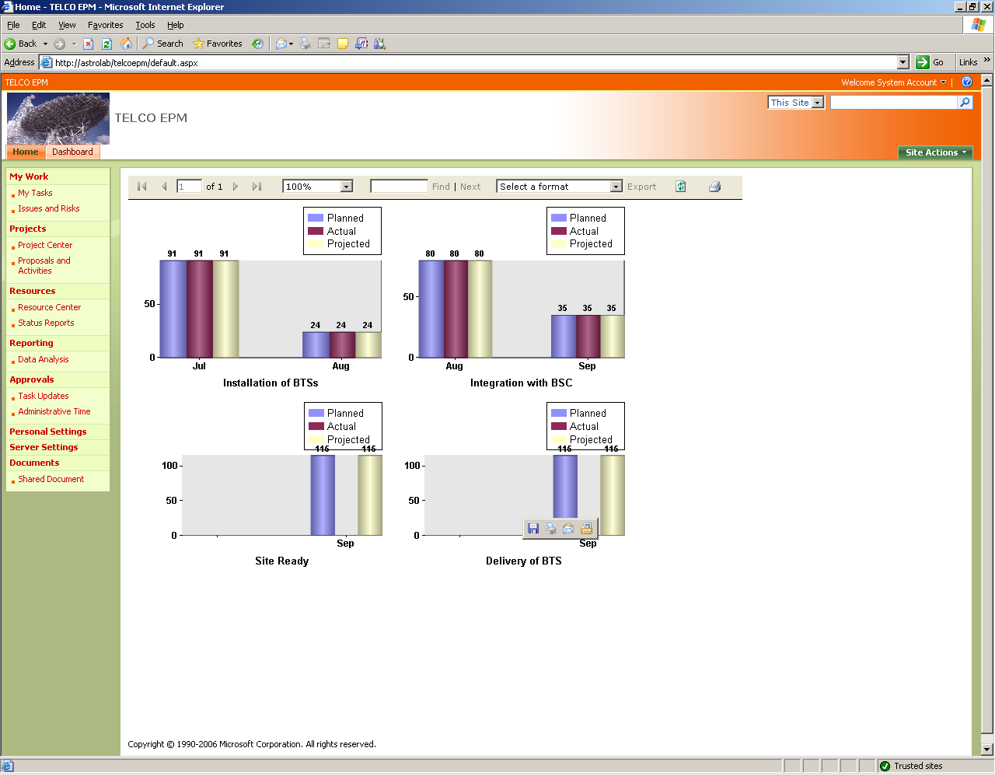
BTS Tracker – Chennai Circle

Slide 10
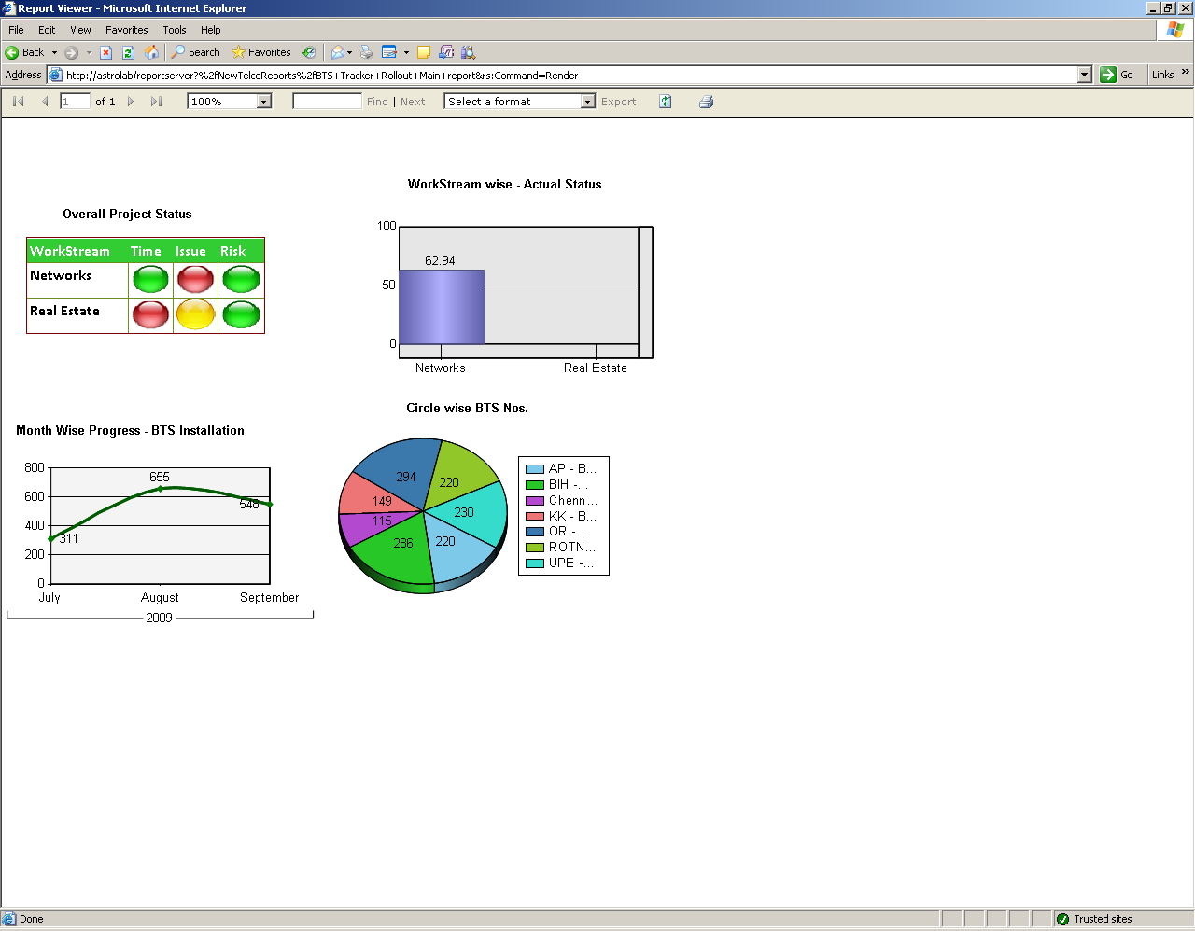
Overall Dashboard

